Slide 1
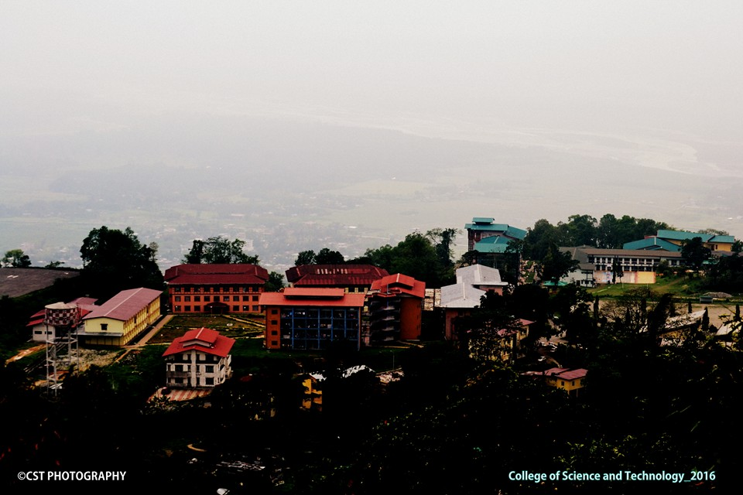
Deepika Suberi Karma Dorji Tek Nath Acharya Karma Tshewang Guide: Mr. Parshu Ram Dhungyel
Easy CST
Mobile Application

Slide 2
Outline
Requirement gathering & analysis
System Requirements
Database Design
UI and Architecture Design
Work Progress

Slide 3

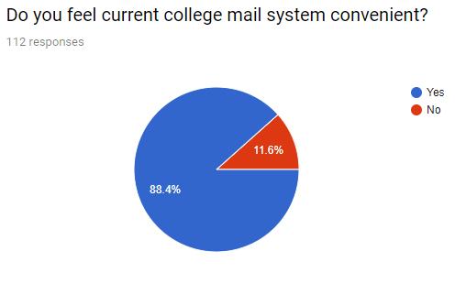
Requirement Gathering & Analysis
A small survey was conducted to gather required features within college with few suggestions from our side.
11/1/2018
3

Slide 4
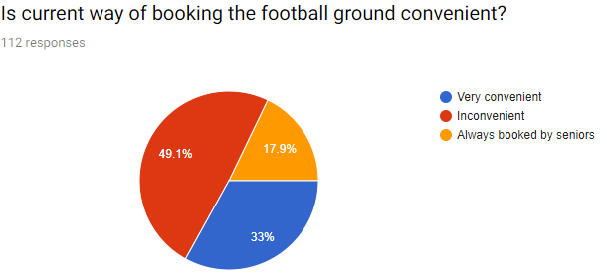
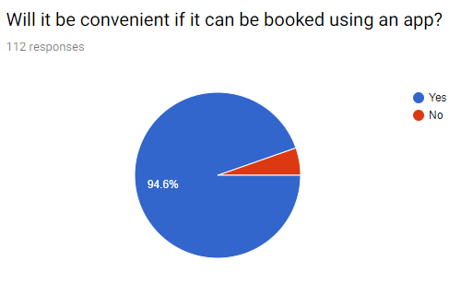
Requirement Gathering & Analysis
11/1/2018
4

Slide 5
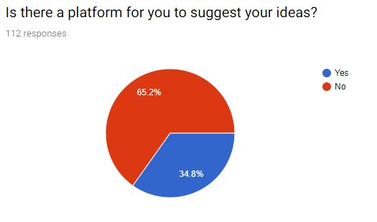
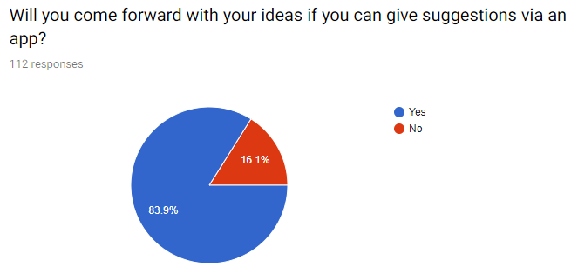
Requirement Gathering & Analysis
11/1/2018
5

Slide 6
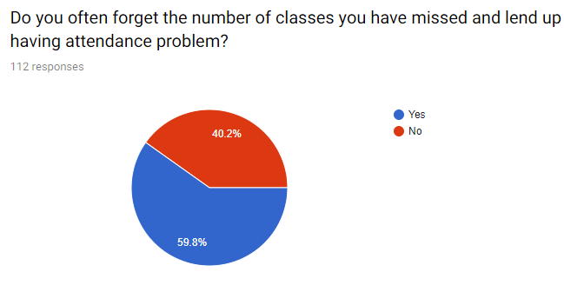
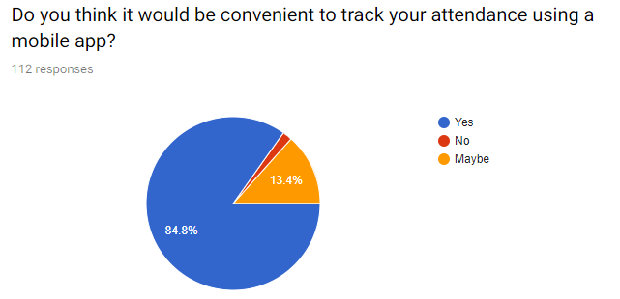
Requirement Gathering & Analysis
11/1/2018
6

Slide 7
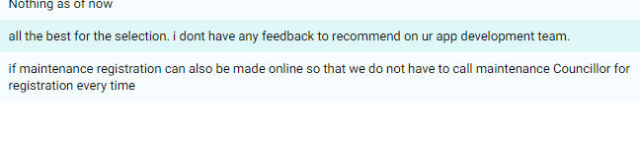
Requirement Gathering & Analysis
11/1/2018
7

Slide 8
System Requirement
1. Software requirements
Windows operating system 7 and above
Java SE jdk1.8.0_144 and above
Android Studio version 3.2 and above
Android SDK-21 and above
Laravel 5.7 latest stable (04/09/2018)
11/1/2018
8

Slide 9
System Requirement
2. Hardware requirements
Minimum 4 GB memory (laptop/desktop)
Android KitKat above for testing
USB cable for debugging
11/1/2018
9

Slide 10
Database Design (Entity Relationship Diagram)
11/1/2018
10

Slide 11
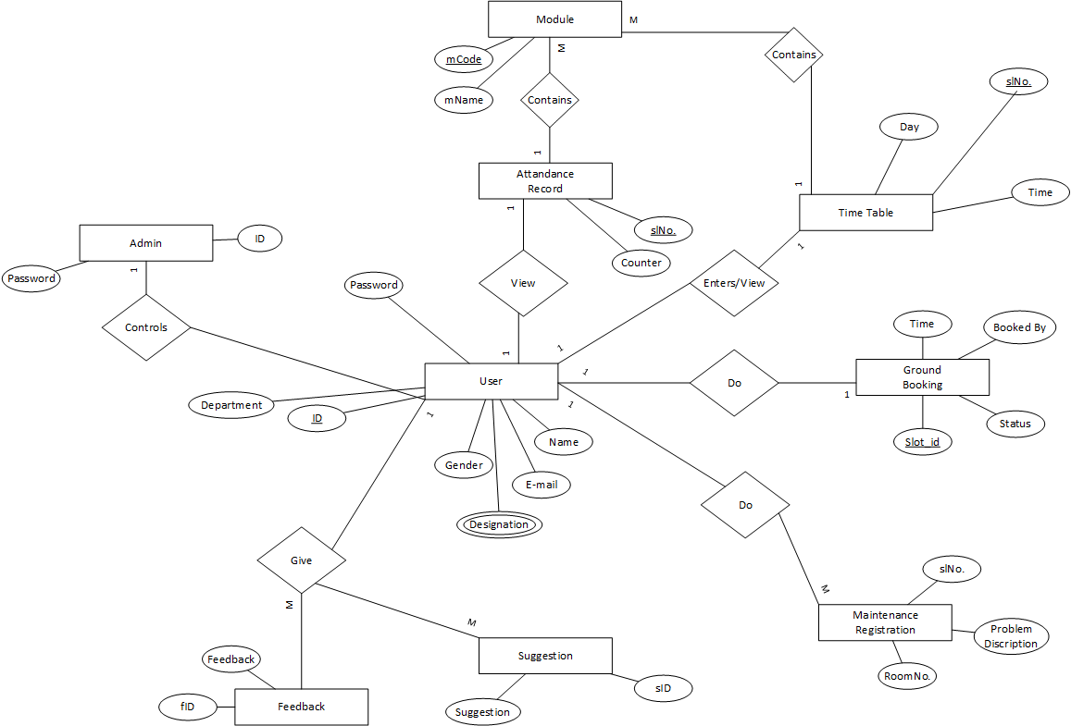
11/1/2018
11

Slide 12
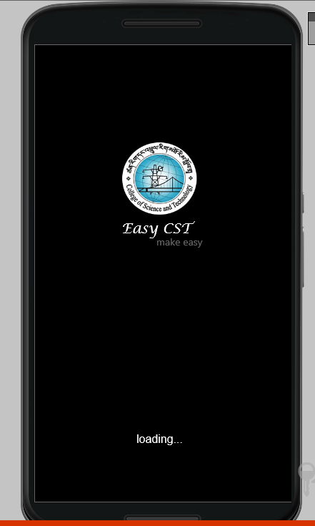
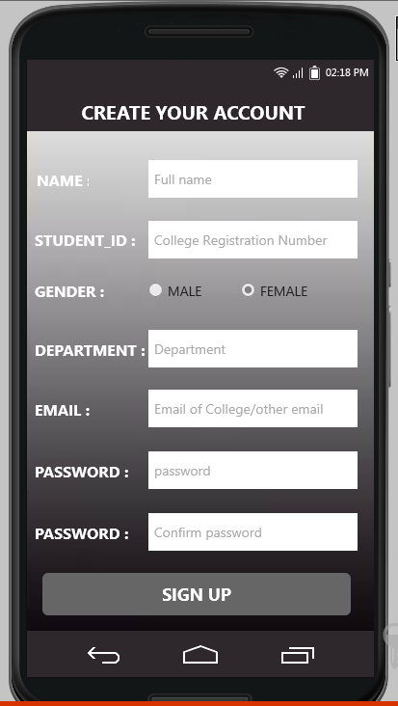
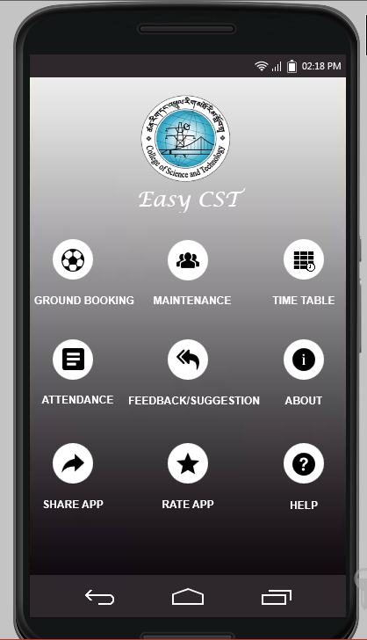
App UI Design
11/1/2018
12

Slide 13
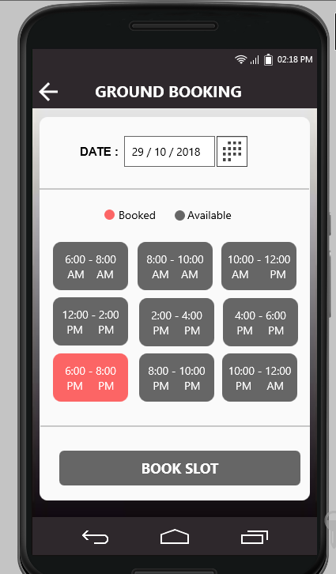
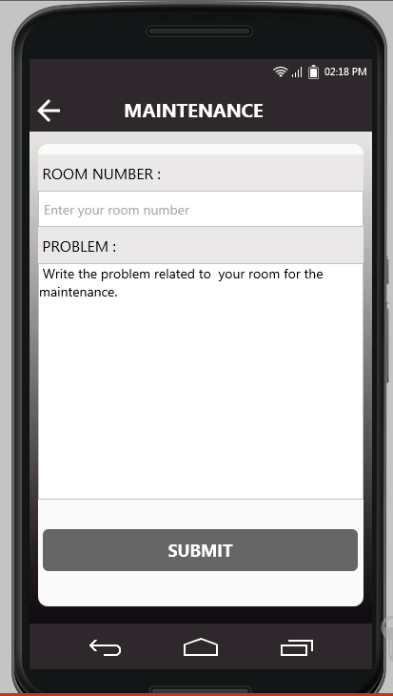
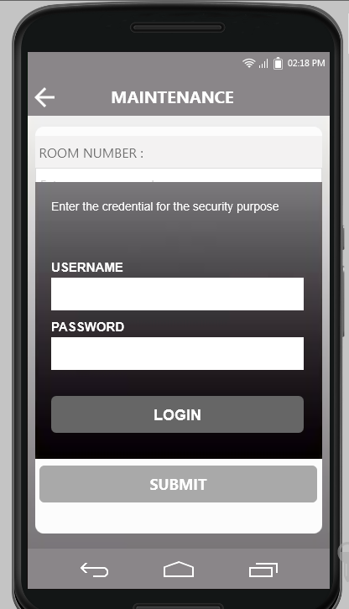
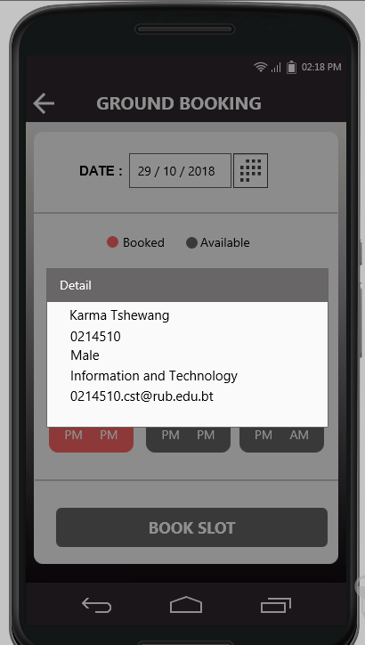
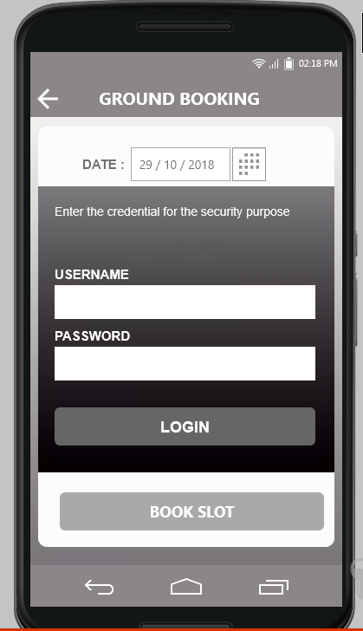
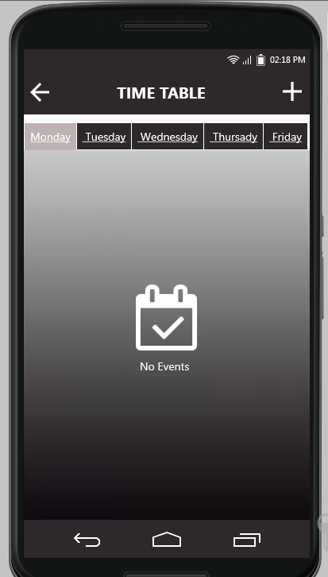
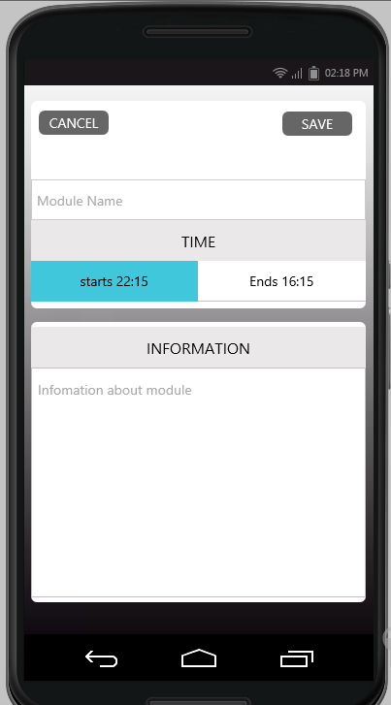
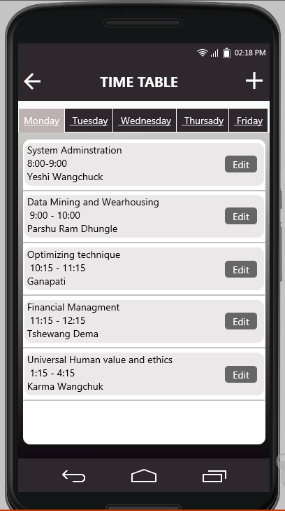
11/1/2018
13

Slide 14
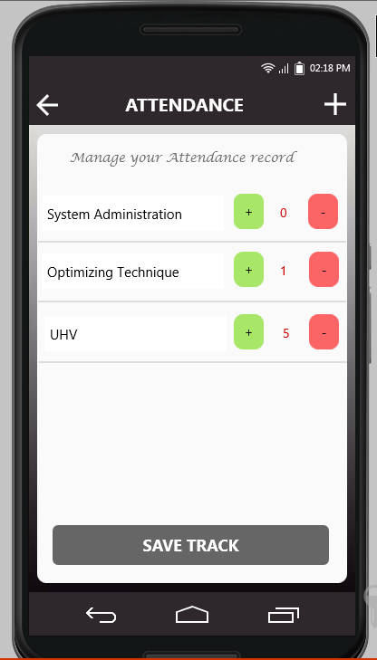
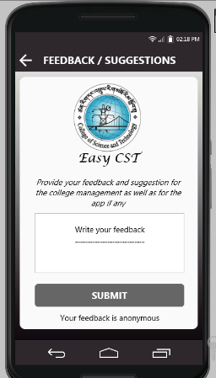
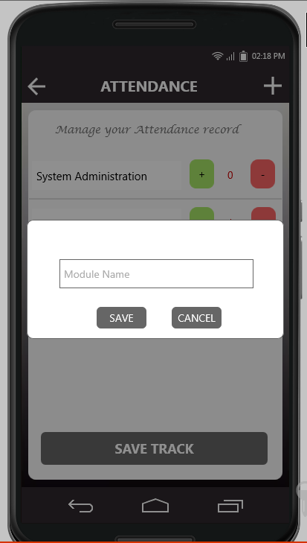
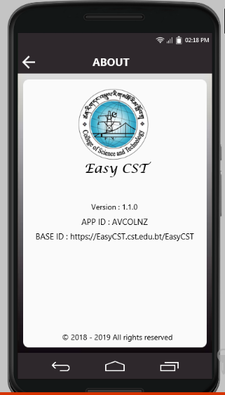
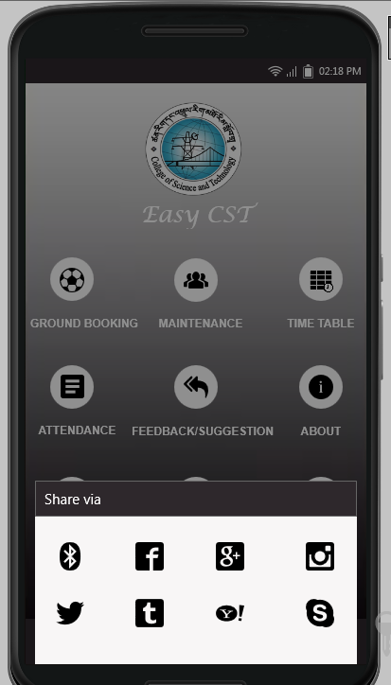
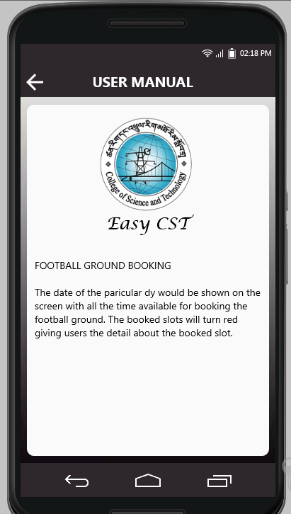
11/1/2018
14

Slide 15
Architecture Design (UML Class Diagram) (UML Use Case)
11/1/2018
15

Slide 16

11/1/2018
16

Slide 17

11/1/2018
17

Slide 18
Work Progress
11/1/2018
18

Slide 19
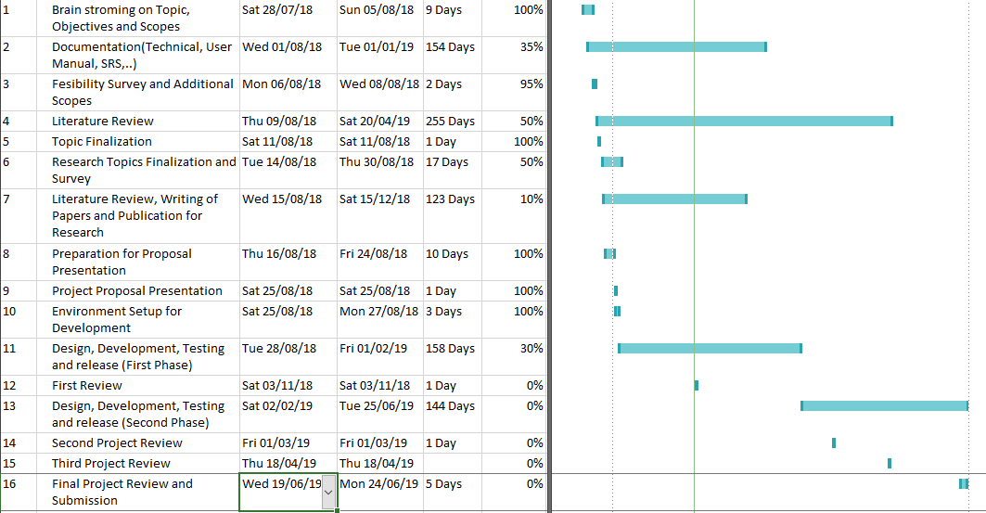
11/1/2018
19

Slide 20
THANK YOU
??
11/1/2018
20

